Slide 1
Clean India Map:Empowring Communation,Enhancing Cleanliness
A crowdsourced initiative for a cleaner india

Slide 2

Clean India Map:Empowring Communation,Enhancing Cleanliness
~A crowdsourced initiative for a cleaner india

Slide 3
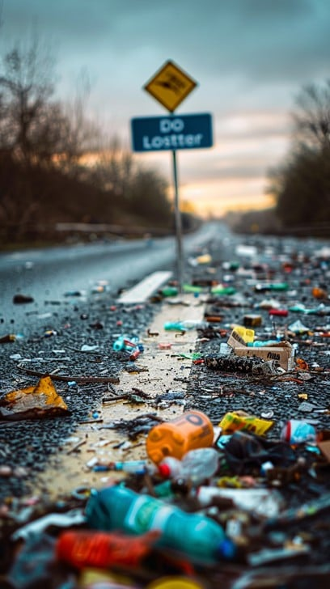
PROBLEM
India faces Significant waste management and Sanitation Issues.
Need for community-driven solutions.

Slide 4
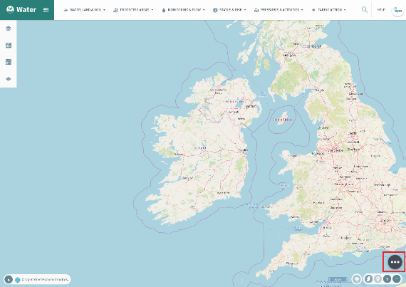
About the Project
Interactive map for reporting cleanness issues (litter , open defecation , etc.).
Connects citizens , volunteers , and authorities.
Promotes awereness and action.

Slide 5
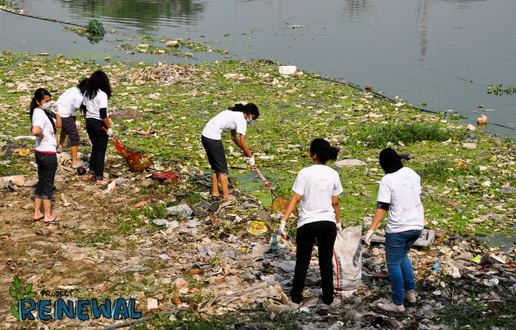
How it works
Report Issues: Pinpoint locations , add photos.
Volunteer: Join clean-up drives.
Track Progress: Status updates(Reported Resolved).
Resources: Tips on Waste segregation , local initiatives.

